Slide 1
CSS 497 2018 Capstone Genetic Algorithmic Networks
Danny Ly
Advisor: Dong Si
Computer Science and Software Engineering

Slide 2

Motivation
Goal since admissions to CS at UWB to get closer to working with Artificial Intelligence
Relevance: Bigger step towards my career goals in Machine learning

Slide 3
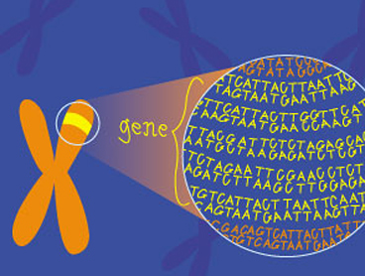
Purpose
Explore what ‘genetic algorithms’ meant
Apply their use to a practical real-world problem
Combing Neural Network’s, Reinforcement Learning, and Genetic Algorithms

Slide 4
Problem
Given an interface to send keys (up, down, none) to a program, can this program learn to play ping pong adequately, based off rewards?

Slide 5
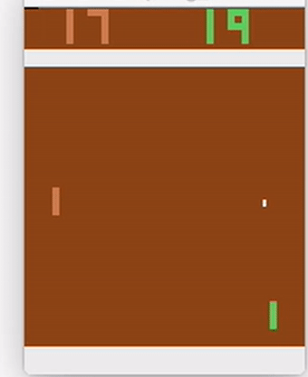
Goal
Using Genetic algorithms find the best hyper parameters that will allow this program to adequately play against another computer.

Slide 6
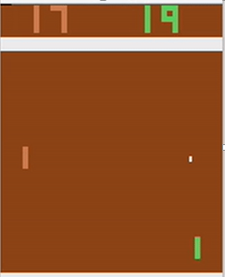
Design Approach
Pixels of the game board
Hidden Layer
Probability of Moving up, down, or not at all
Image Classification
Aims at turning on specific Neurons

Slide 7
Genetic Algorithm program flow
Initial Neural Network Population
Network Plays in their on environments
Pick Two top Performing Networks
Breed Top performers together
Combine Top Performers, their spawn, and mutated Networks into Population
Remove 50 % of population and the remaining Networks

Slide 8
Program Work Flow (MAYBE REMOE)
Down Sample
Start Environment
Extract Environment Raw Pixels
Preprocess raw Pixels
Apply Neural Network
Remove Color
Reshape
Evaluate Performance
Re-Train Network
Calculate Reward

Slide 9
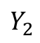
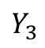
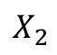
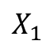
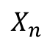
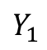
Neural Network Architecture
Input Layer
Hidden Layer
Output Layer
$$X_{1}$$
Σ
Σ
Σ
$$Y_{1}$$
$$X_{2}$$
Σ
Σ
Σ
$$Y_{2}$$
Network Outputs
Network inputs
Σ
$$Y_{3}$$
$$X_{n}$$
Σ
Σ
Neuron
Bias
1
1

Slide 10
Neural Network Design (TO REMOVE)
P
W1
A1
W2
N1
N2
A2
200X6400
200X1
200X1
3X1
3X1
3X200
6400X1
B1
B2
200X1
3X1
N1 =( (W1 * P) + B1)
A1 = ReLu(N1)
N2 =( (A1 * W2) + B2)
a2 =( SoftMax(N2))

Slide 11
Tools
Python
OpenAI Gym
GitHub
Docker
Digital Ocean
Numpy

Slide 12
Pre-Trial Results
Green Is Network, first Model made
Model was stuck at the top or stuck at the bottom

Slide 13
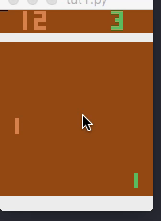
Results
Green is the Model playing adequately well
After changing the model to use a softmax activation function the paddle is more stable

Slide 14
Application(TO REMOVE)
Things such as Manufacturing
Warehouse robots that put stock into packages, when packages fall out of the box, the machine learns self awareness of its surrounding, making sure it
Tesla – uses lots of intelligent machines that use reinforcement learning to correctly sort, build, assemble cars, reinforcement learning is viewed as ways to make sure machines are iteratively correcting bad behaviors and or practices
Genetic Reinforcement learning is still fairly new, the applications of genetic algorithms for hyper parameter tuning allows networks to possibly find hidden behaviors that were to complex to compute by hand alone.

Slide 15
Lessons Learned
I learned that Genetic Algorithms are mainly used as a means to find the hyper parameters of a model
However the hyper parameters can quickly be found, searching to deep will overshoot the optimal minima
I learned hands on approach to collecting, preprocessing, building, and training a neural network model.

